Slide 1
CAMPUS FACILITIES MANAGEMENT SYSTEM
SOFTWARE ENGINEERING PROJECT

Slide 2
Agenda
Introduction
Problem Statement
Project Features
Benefits
Team Members
Summary

Slide 3
Introduction
We present the "Comprehensive Campus Services Management System." This innovative web-based platform seeks to address a range of challenges, including hostel-related issues like filing complaints against plumbing, carpentry, cleaning, and electrical concerns, along with introducing solutions for other aspects of campus life. The primary objective is to provide an all-in-one solution that enhances convenience, efficiency, and user experience for students.

Slide 4
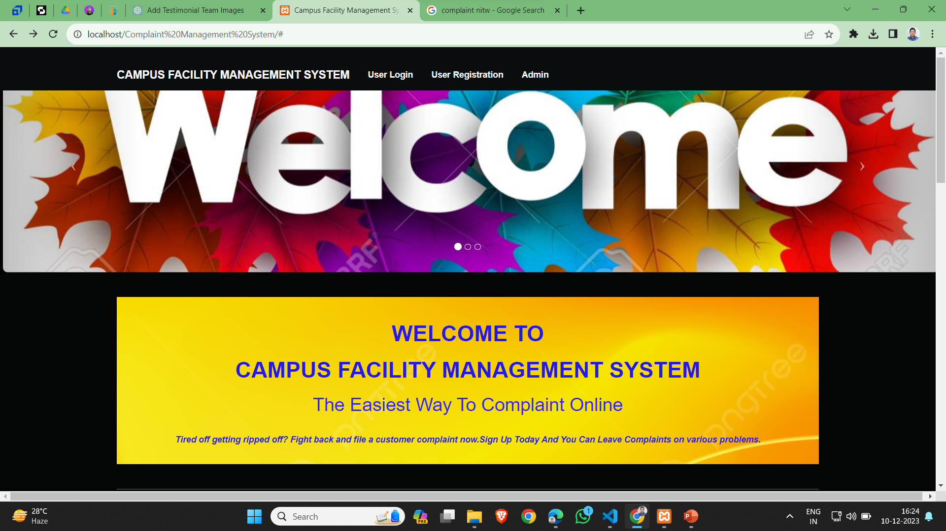
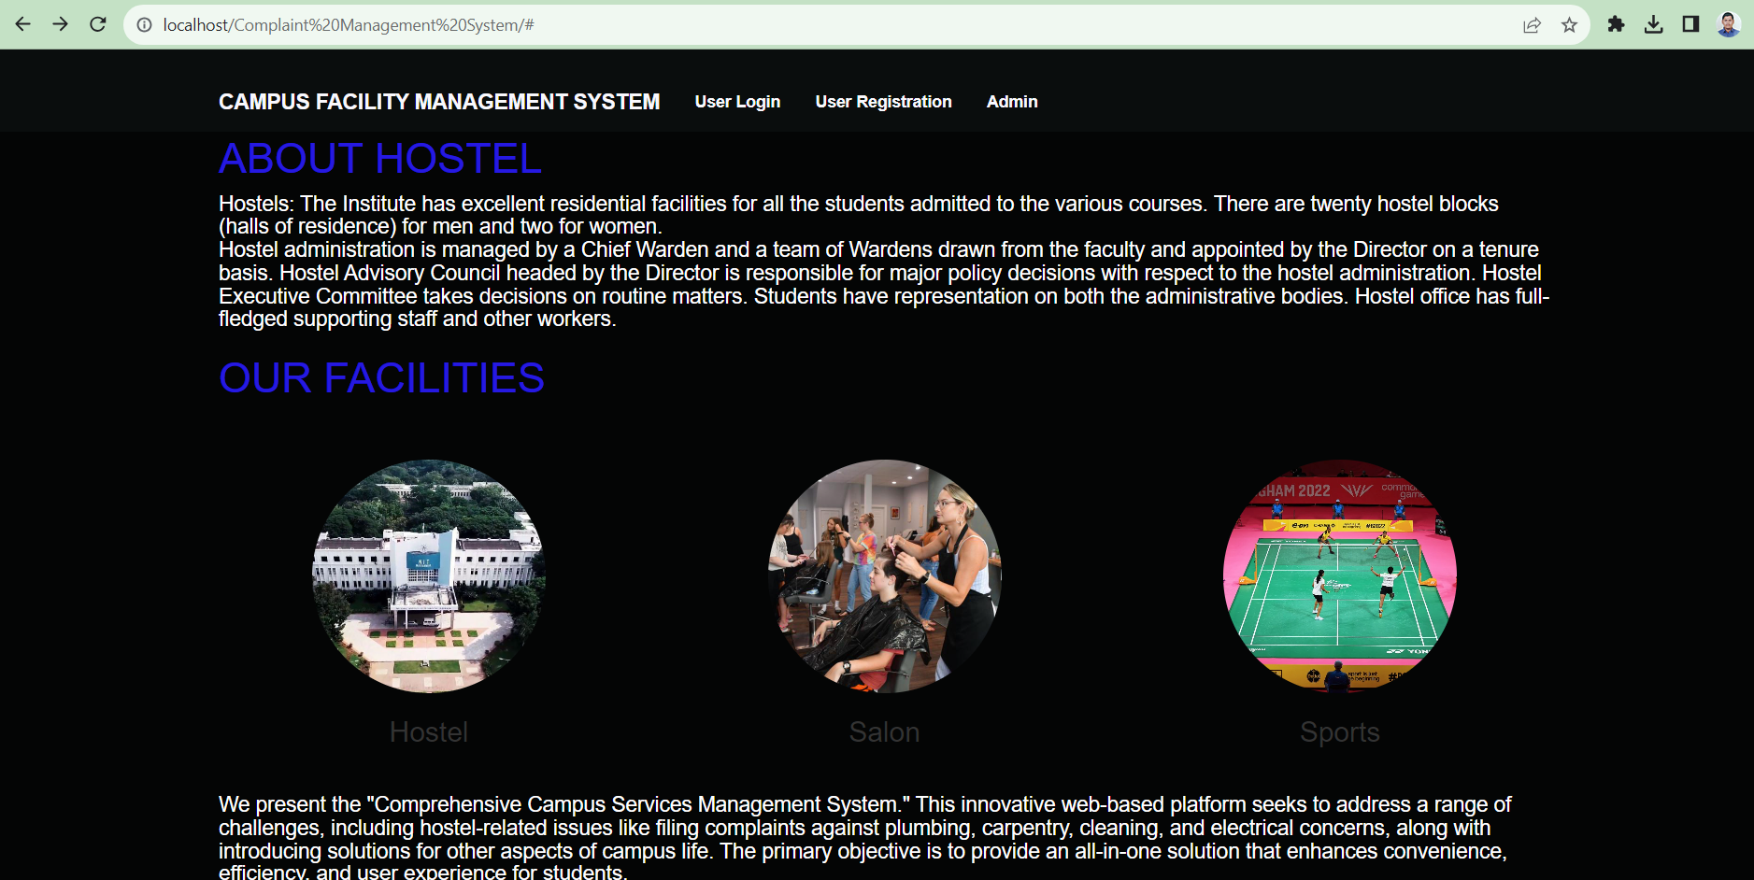
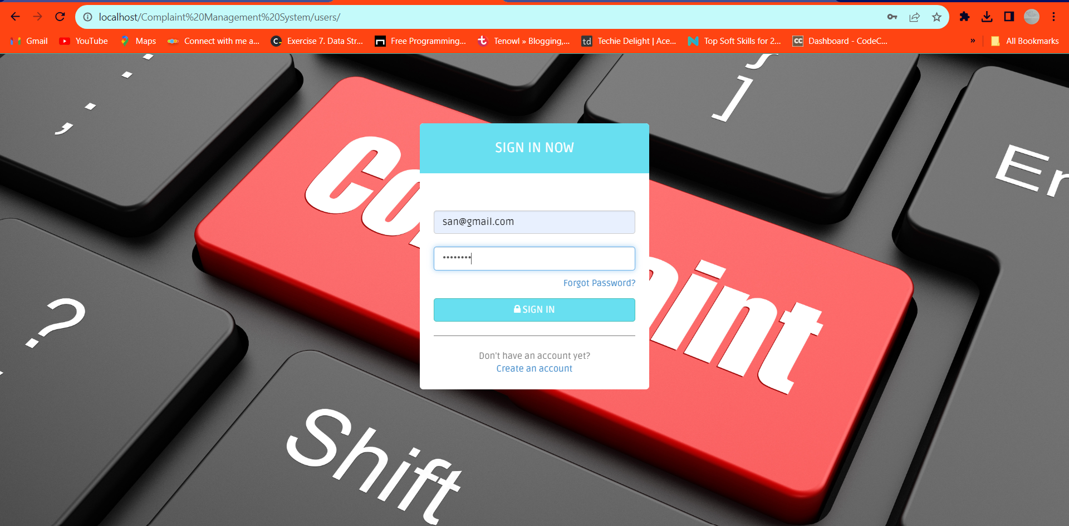
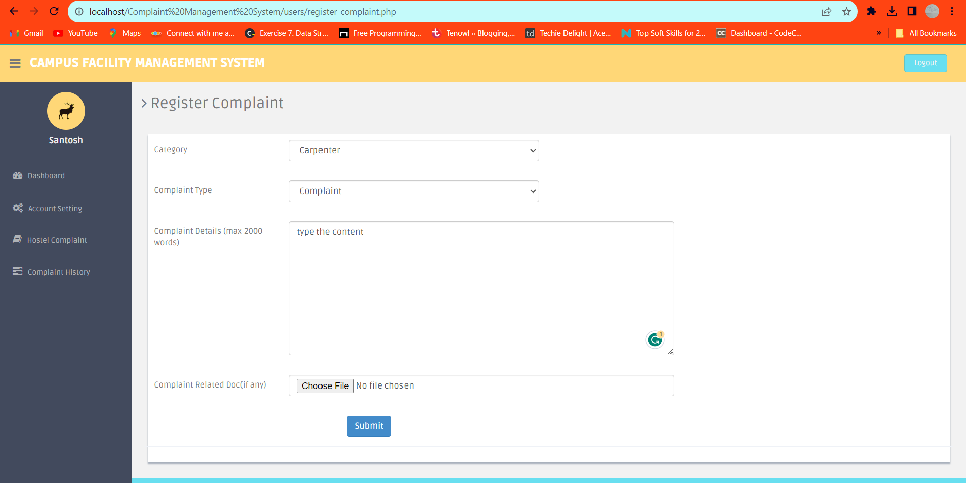
output

Slide 5
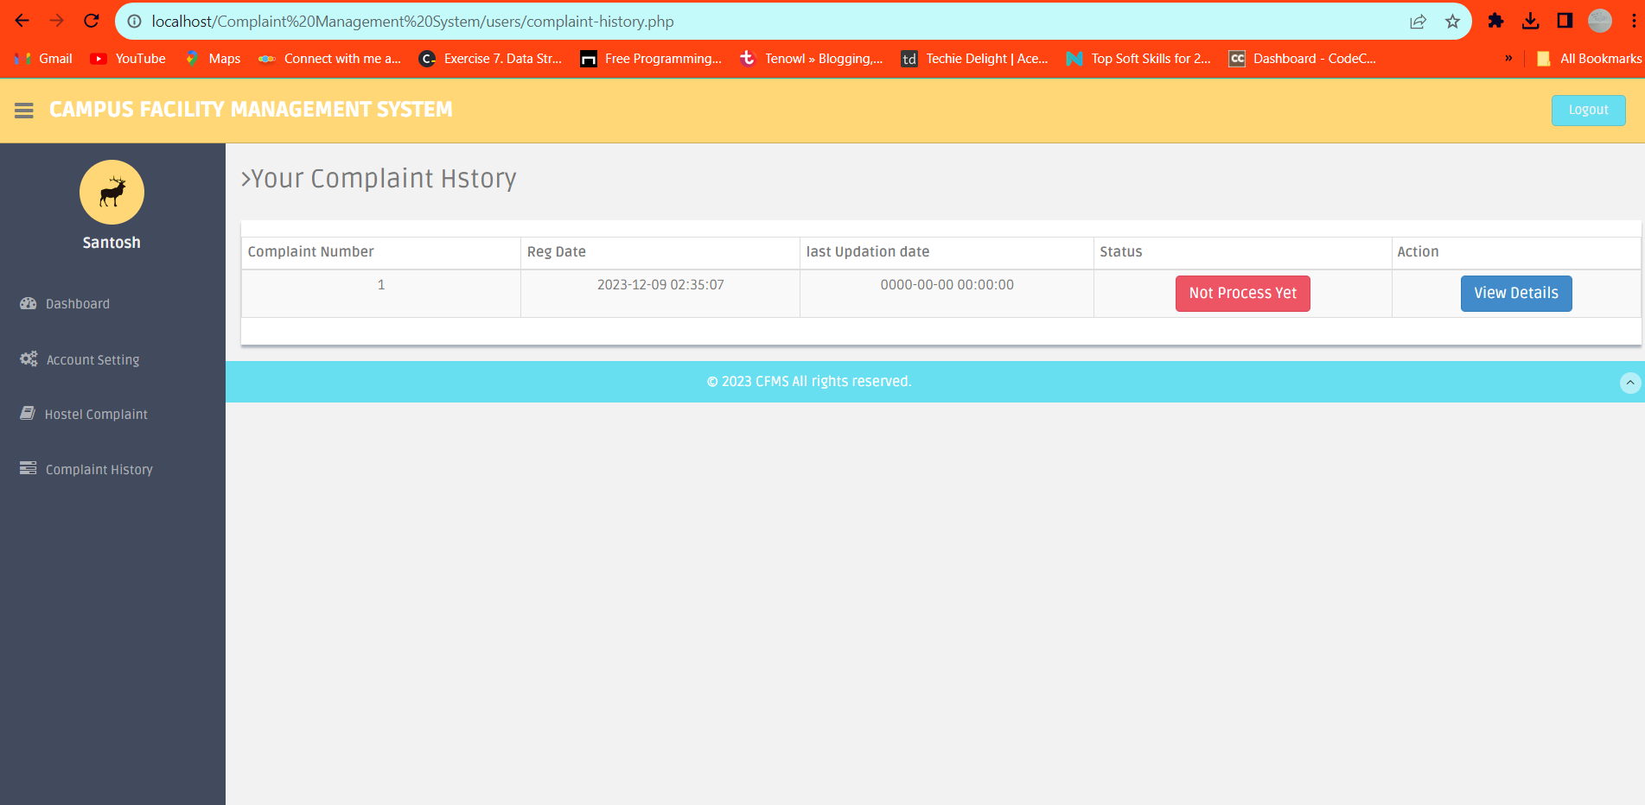
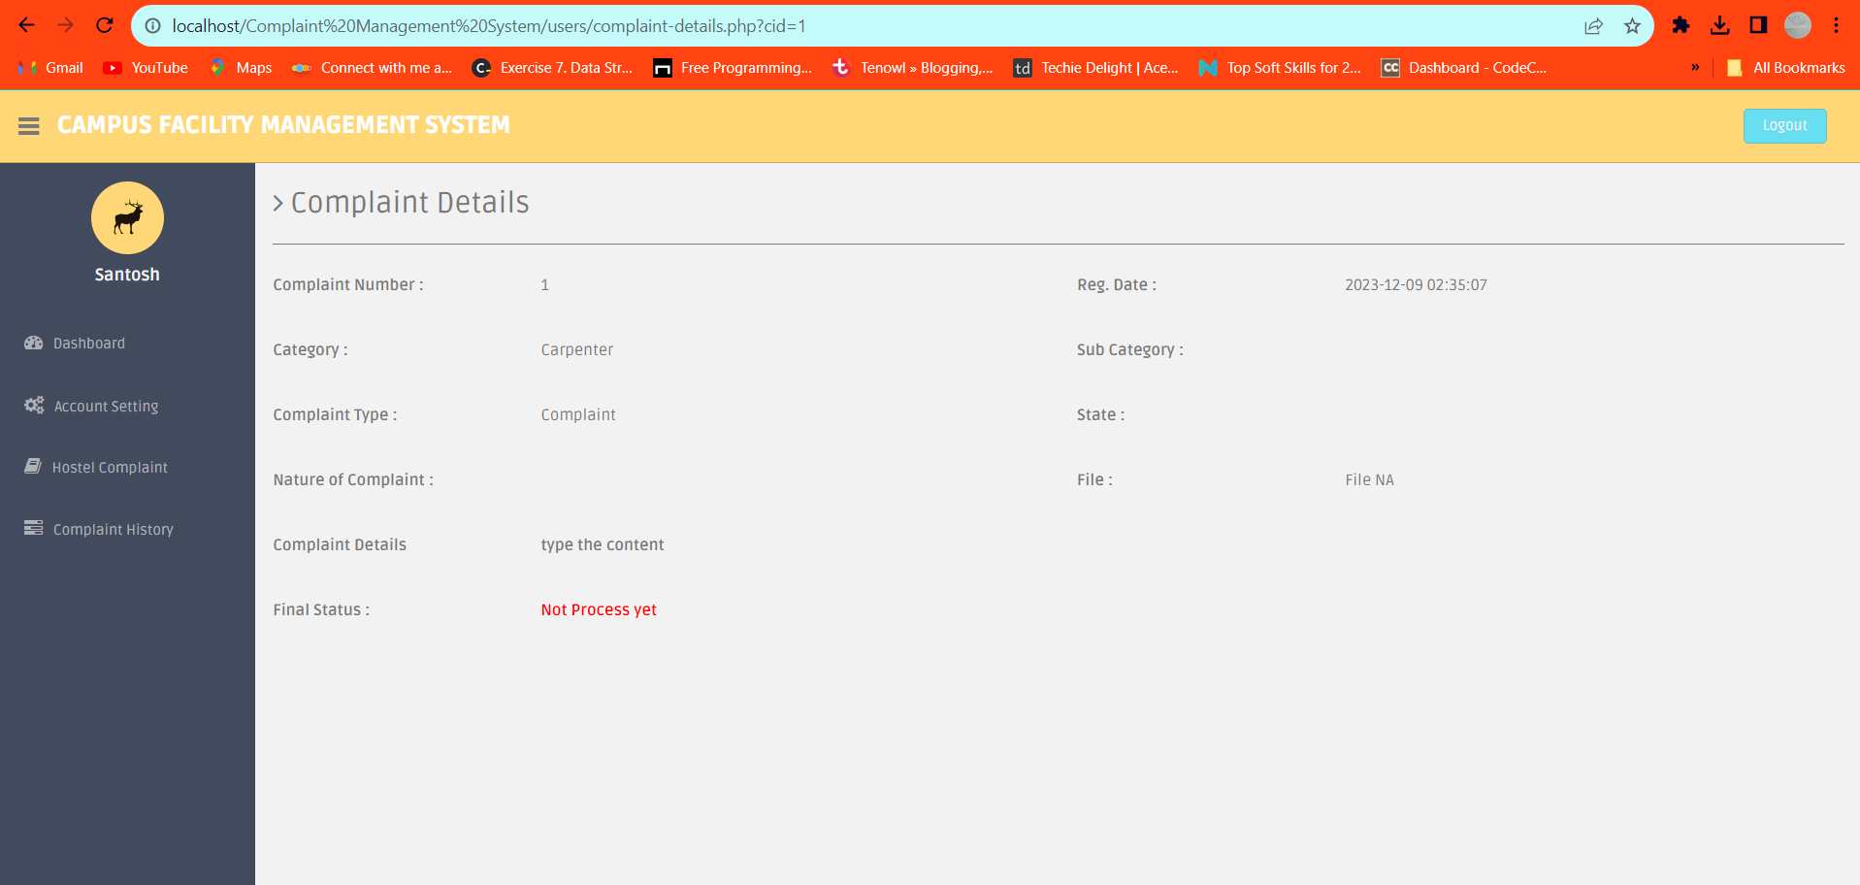
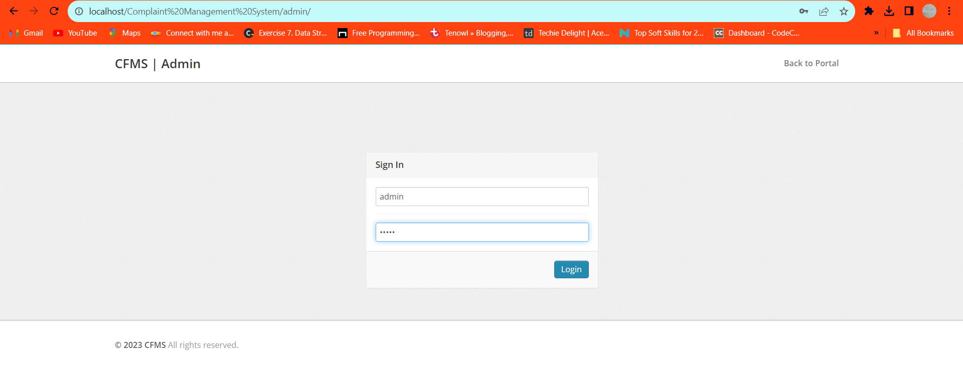
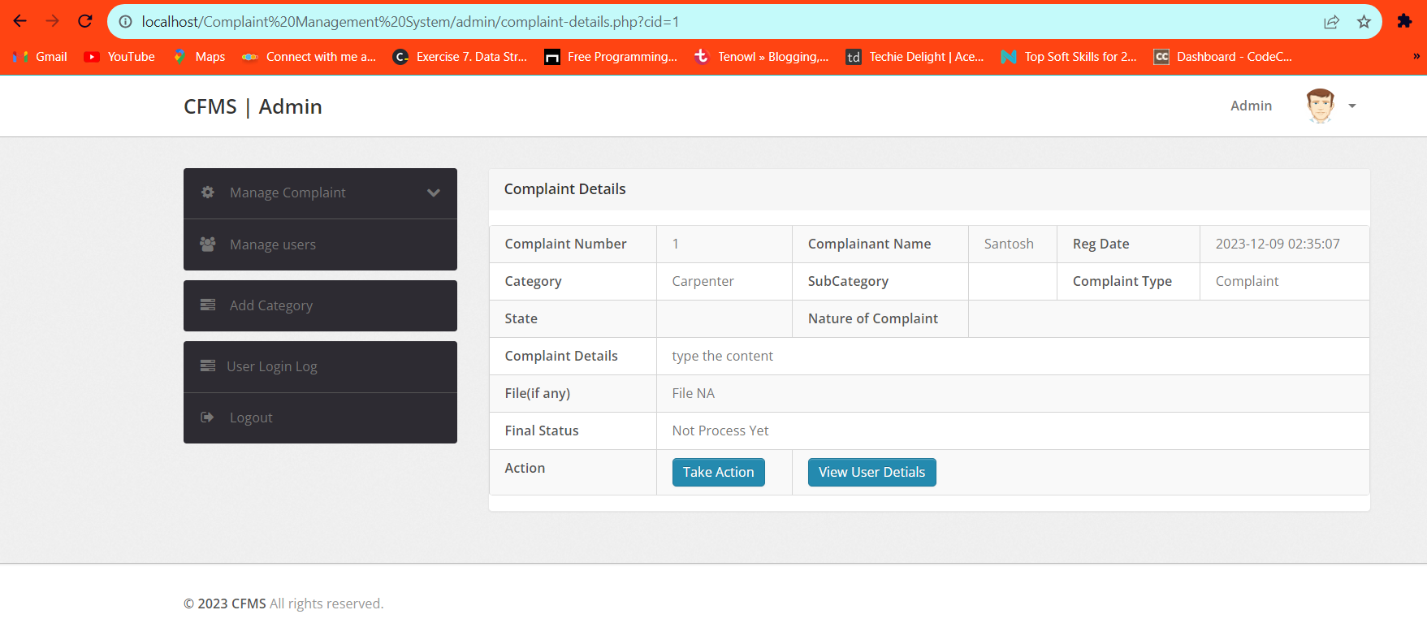
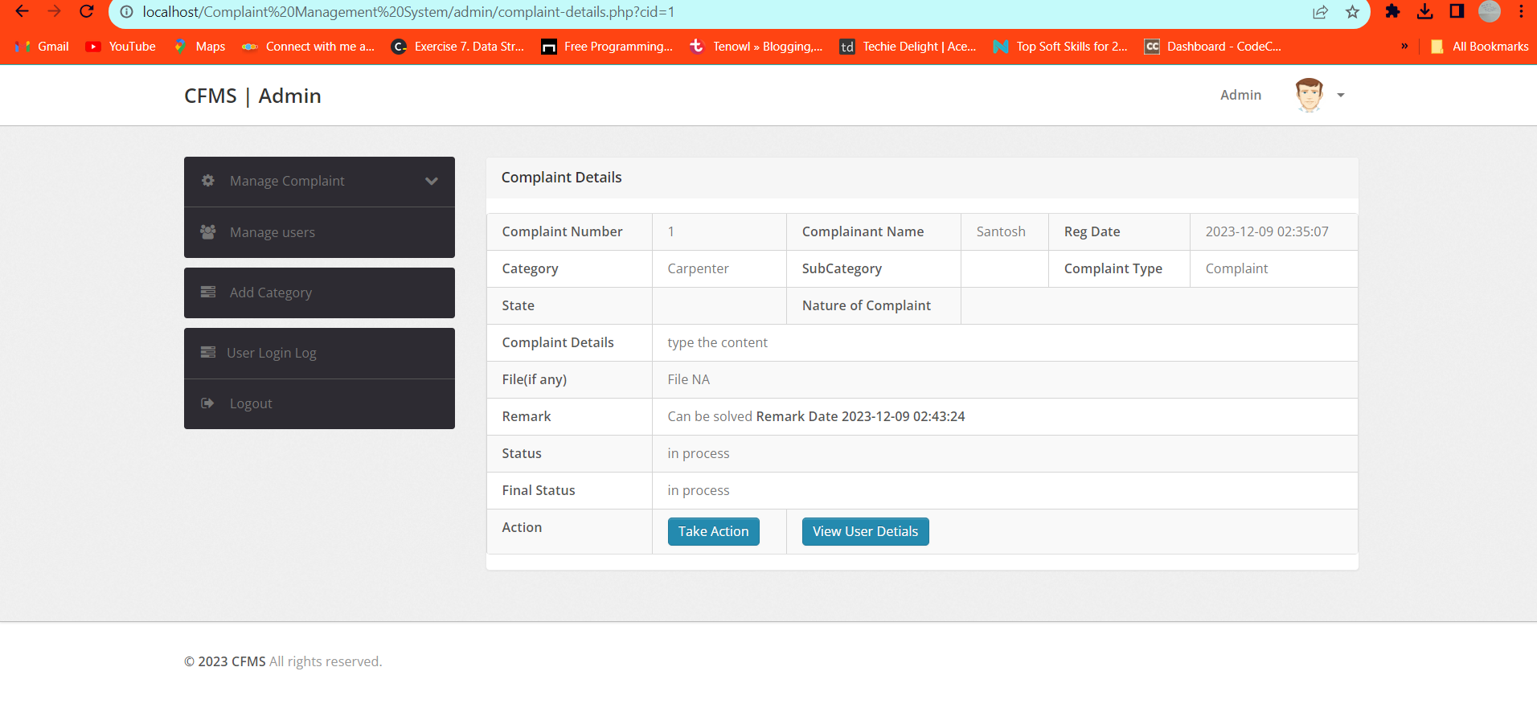

Slide 6
Problem Statement
Our system aims to simplify issue reporting and resolution, ensuring a more comfortable living environment for students. Student can file and also can check the status of the complaints.
Campus Salon Appointment System
Slot Booking for Games(Badminton) and Gym

Slide 7
Project Features
User Registration and Login for personalized access.
Hostel Issue Reporting: Students can choose a problem category, describe the issue, and submit it online. The system notifies relevant staff members.
Admin Dashboard: Admins can manage reported issues, assign tasks to staff, and track problem resolution.
Salon Appointment Booking: Students can book salon appointments based on available time slots, eliminating unnecessary waiting.
Slot Booking for Games(Badminton) and Gym: Introduce the slot booking system for students to reserve times for playing games and using the gym.

Slide 8
Benefits
Enhanced Hostel Experience: Swift resolution of facility-related issues ensures a conducive living environment.
Timely Salon Services: Slot-based appointments minimize waiting and provide a structured salon experience.
Introducing a slot booking system for games and the gym optimizes facility use and reduces waiting times, offering students convenience and safety.

Slide 9
Module 1: User Management (Registration and Login) Team Member 1: Responsible for developing the user registration and login system. This includes designing registration forms, handling user authentication, and ensuring data security. Module 2: Issue Reporting System Team Member 2: Tasked with creating the issue reporting system. This module involves designing the user interface for problem selection and submission, validating and storing user inputs, and implementing notifications to relevant staff members. Module 3: Admin Dashboard and Staff Management Team Member 3: Focus on building the admin dashboard. This includes creating an interface for staff members to manage reported issues, assign tasks to staff, and track the status of problem resolution. Module 4: Campus Salon Appointment Team Member 4: This module includes designing a slot-based booking system, handling appointment scheduling, and sending appointment reminders if needed Module 5: Sports Slot Booking System Team Member 5: This module includes designing a slot-based booking system, handling appointment scheduling, and sending appointment reminders if needed.

Slide 10
Meet our team
Deepak
Rohith Gahlawat
22MCF1R16
22MCF1R43
Ramavath Santhosh
22MCF1R40
Animesh Paswan
Rushikesh Khiste
22MCF1R06
22MCF1R45

Slide 11
Summary
By addressing these challenges and providing innovative solutions, the "Comprehensive Campus Services Management System" endeavors to enhance the quality of life for students, making campus living more comfortable, efficient, and enjoyable.

